Slide 1



From ETL to Insights
A Dream Team Presentation

Slide 2
Project Workflow
Brainstorming
Transforming/Loading
01
04
Objectives
Analysis
02
05
Data Preparing
Conclusion
03
06
Gathering ideas
Selecting our topic and data sets
Cleaning
Loading data to SQL server
What do we wish to discover?
What do we need to do?
Using analyzing tools to answer our questions
Extracting variables
Challenges faced
What could be done better?

Slide 3
Brainstorming
01

Slide 4

Why Airbnb?
Airbnb’s data is collected by an advocacy group called Inside Airbnb.
Data files are organized by city ➤ can easily select preferred cities for study.
Data is easy to understand ➤ data dictionary.
Gives us a taste of what it’s like to handle big data for a consumer brand.
As Travellers, we're familiar with Airbnb's data set 🧳

Slide 5

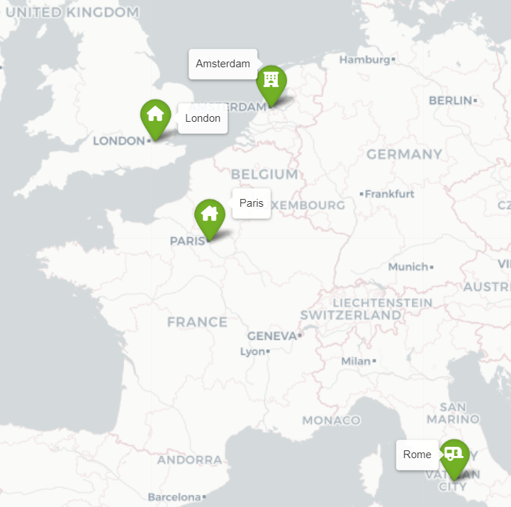
Which Cities to Focus On?

Slide 6

Data Observations
In our Airbnb data sets, location data was stored as latitude and longitude coordinates. Possibly mirrors how Airbnb stores location data. If coordinates are derived from a physical address ➢
"geocoding."
Some advantages:
Pinpoint a specific location within a city.
Caters for locations with the same name.
Precise distance calculations between a potential stay and landmarks or attractions ➢ only possible with exact coordinates.
Regulatory requirements, tax rates, and legal permissions can vary within different areas of a city.

Slide 7
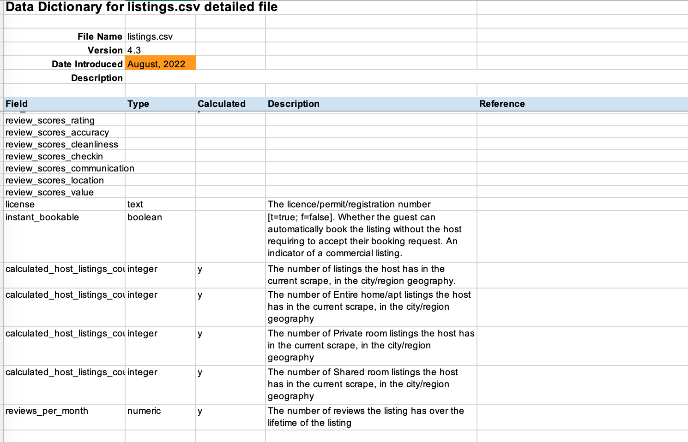
Data Dictionary
Although no description was provided for the "review_scores" fields, as Airbnb users, we knew what these scores referred to.

Slide 8
Objectives
02

Slide 9

Our Questions
Primary questions:​​
For each city, are reviews more positive or negative?​​
What are the most frequent words for the reviews? What can this tell us about consumer concerns?​​
Is there a correlation between price and review sentiment? (E.g. Do reviews tend to become more positive or negative as prices increase?)​​
Which cities have the highest rating scores — overall, as well as for specific qualities?​​
​
​​ "Bonus" questions:​​
Do more experienced Airbnb hosts get more positive or negative reviews?​​
For Airbnb Superhosts, are their reviews more positive or negative? ​​
For Airbnb hosts who don’t verify their identity, does this impact their rating?​​
Which types of homes receive the most positive reviews?​

Slide 10
Data Preparing
03

Slide 11
Data Selection: Listings
From 75 fields in the “listings” data, we extracted:
id | the unique id for each listing
name | name of the listing
host_since
host_location
host_is_superhost
host_identity_verified
property_type
price
review_scores_rating
review_scores_accuracy | does the actual home match its description?
review_scores_cleanliness | how clean is the home?
review_scores_checkin | how smooth is the check-in process?
review_scores_communication | is it easy to communicate with the host?
review_scores_location | is the location good for travellers?
review_scores_value | is the home value for money?

Slide 12
Data Selection: Reviews
From 6 fields in the “reviews” data, we extracted:
listing_id
date
comments | review text

Slide 13
Project Goals
Data Cleaning & Transformation
Data Analysis
Data Insights
Use real-world data to simulate the ETL work of data engineers.
Explore Python libraries for text analysis: Which tools are more effective?
Find different ways to draw useful insights from our data set.

Slide 14
Transforming/Loading
04

Slide 15


Where to Host the Data?

Slide 16
Where to Host the Data?
What is Supabase:
Build on PostgreSQL online server
Allows user to host database online and share with others
Advantage over PgAdmin?:
User can do query online and is recorded in real time.
Provides coding help similar like chatgpt for SQL.
Disadvantage:
Limit to the file size being uploaded.
Limited Database size.
Limit to 2 Database.
Only 1 way to create table header, manually setup in Supabase.

Slide 17
Data Preparation
2 groups of data:
Listing Info, Guest Reviews
Listing Group:
Remove unwanted columns and special characters.
Review Group:
Preprocess the CSV files before reading into dataframes.
Encoding set to UTF-8
Remove HTML tag <br/>
Parallel Processing to optimize the process

Slide 18

Data Loading
Workflow:
Set up connection to PostgreSQL Server.
Define a database name.
Create a connection engine to the database.
Use a for loop to create all the 10 tables.
Read all the cleaned data into dataframes and ingest to PostgreSQL

Slide 19
Analysis
05

Slide 20


Sentiment Analysis: Quick Facts
VS
How it Works:
Breaking Down the Text:
Text is split into smaller pieces (common phrases, words, or parts of words), for easier analysis.
2. Understanding the Tone:
Sentiment analysis models may look at individual words and phrases, or they may consider the whole context of the sentence or paragraph.
Deciding the Overall Sentiment:
A score is generated, to indicate if the text is more positive or negative. Some models also score for neutrality.

Slide 21
Sentiment Analysis: Different Tools
Comparing 3 Sentiment Analysis Tools
Text Blob
Transformer
VADER

Slide 22


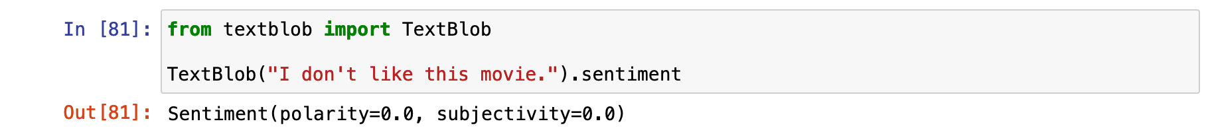
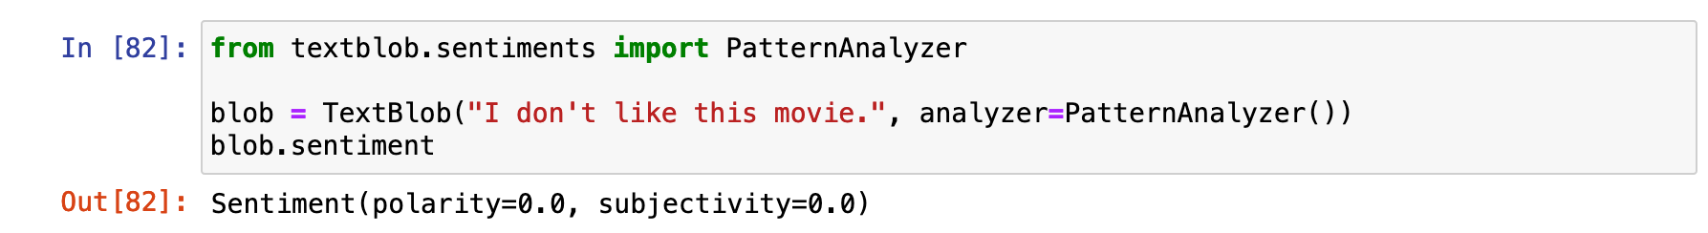
Sentiment Analysis: Text Blob

Slide 23
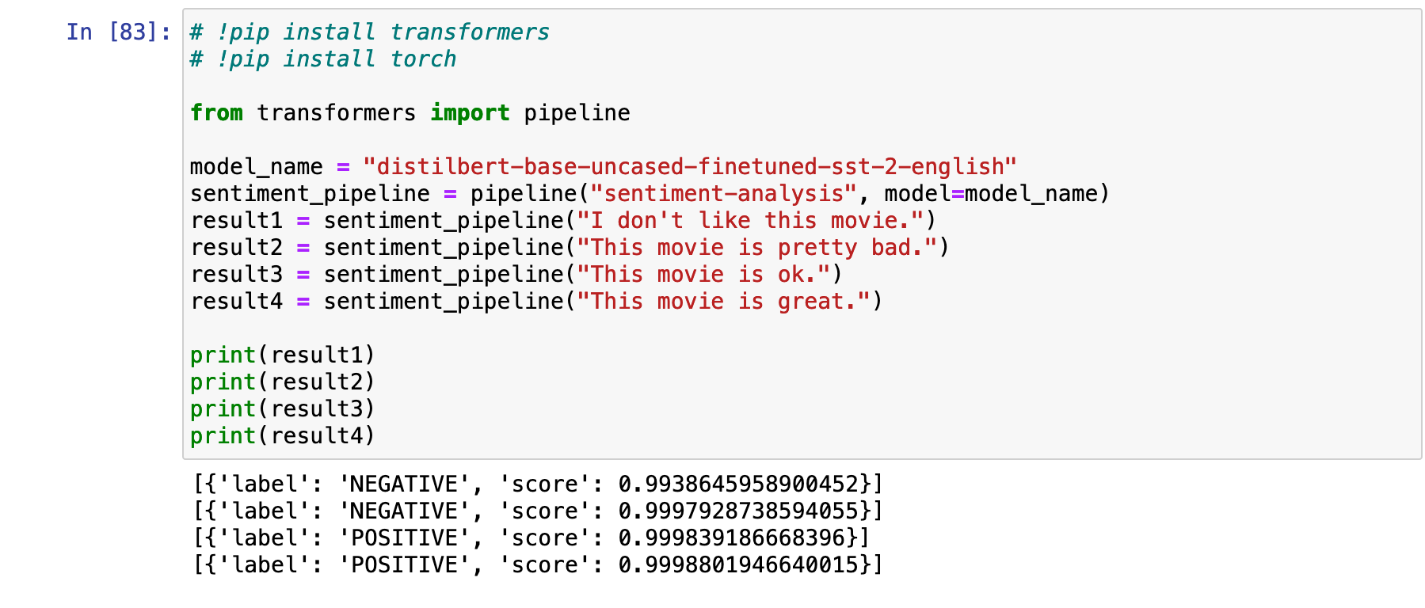

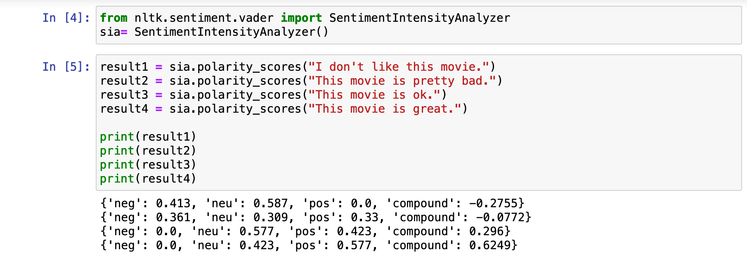
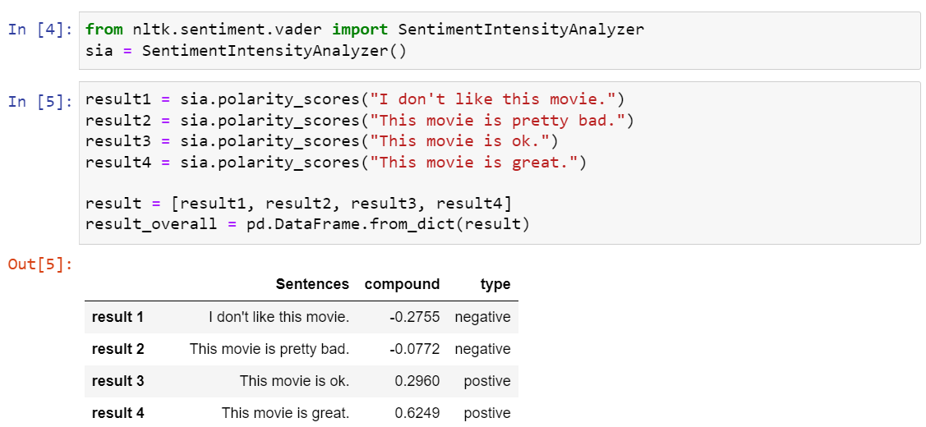
Sentiment Analysis: Transformers Vs. Vader

Slide 24
Sentiment Analysis: Models
Model 1: "DistilBERT base uncased finetuned SST-2"
VS
Model 2: VADER
Example Sentence: "The plot had some truly unexpected twists that really threw me off, but in a good way!"
VADER: assigns scores to words like "unexpected" and "good." If a common phrase like "threw me off" is in its lexicon, it will score that as a phrase.
BERT: BERT stands for Bidirectional Encoder Representations from Transformers. Looks at the whole sentence, is designed to understand that "unexpected" and "threw me off" are positives in this sentence.

Slide 25
Sentiment Analysis: Process
Putting "BERT" from Transformers to work:
Each comment is checked for length, truncated if too long.
"BERT" analyses the sentiment of each comment—generates a sentiment score and label, but we only need the label.
Add "sentiment_label" as a new column to the DataFrame. Based on the count of Positive sentiment labels, the overall sentiment for the comments in each table is determined and printed—'Mostly Positive,' 'Mostly Negative,' or 'Neutral' (same number of positive and negative comments).
Applying "VADER":
VADER generates a compound score for each comment.
Depending on the score, they are categorised as follows:
Positive sentiment, compound >= 0.05
Negative sentiment, compound <= -0.05
Neutral sentiment, compound between -0.05 to 0.05

Slide 26
Meeting our Objectives
Sentiment​ Analysis:​ Answering
Data
Questions

Slide 27
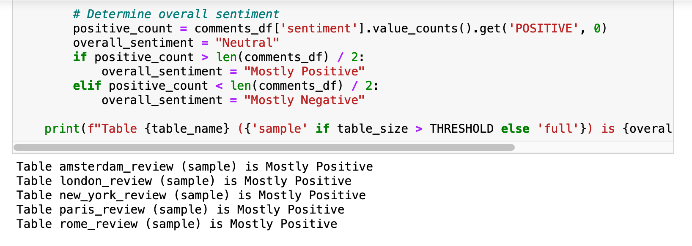
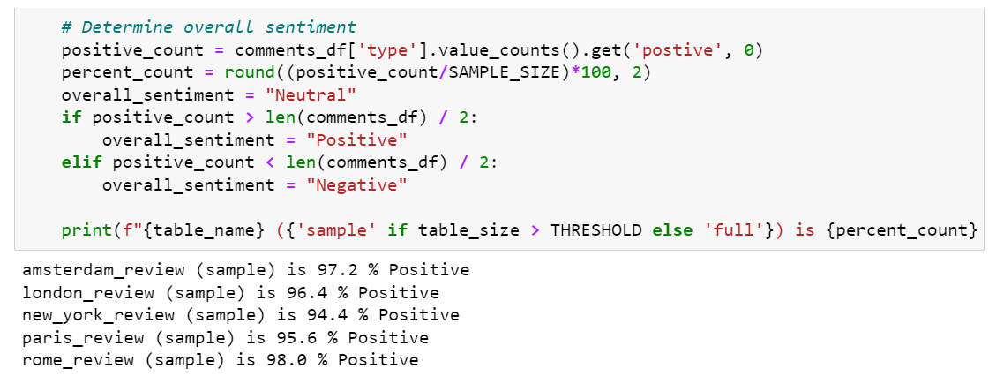
Sentiment Analysis: For each city, are reviews more positive or negative?

Slide 28
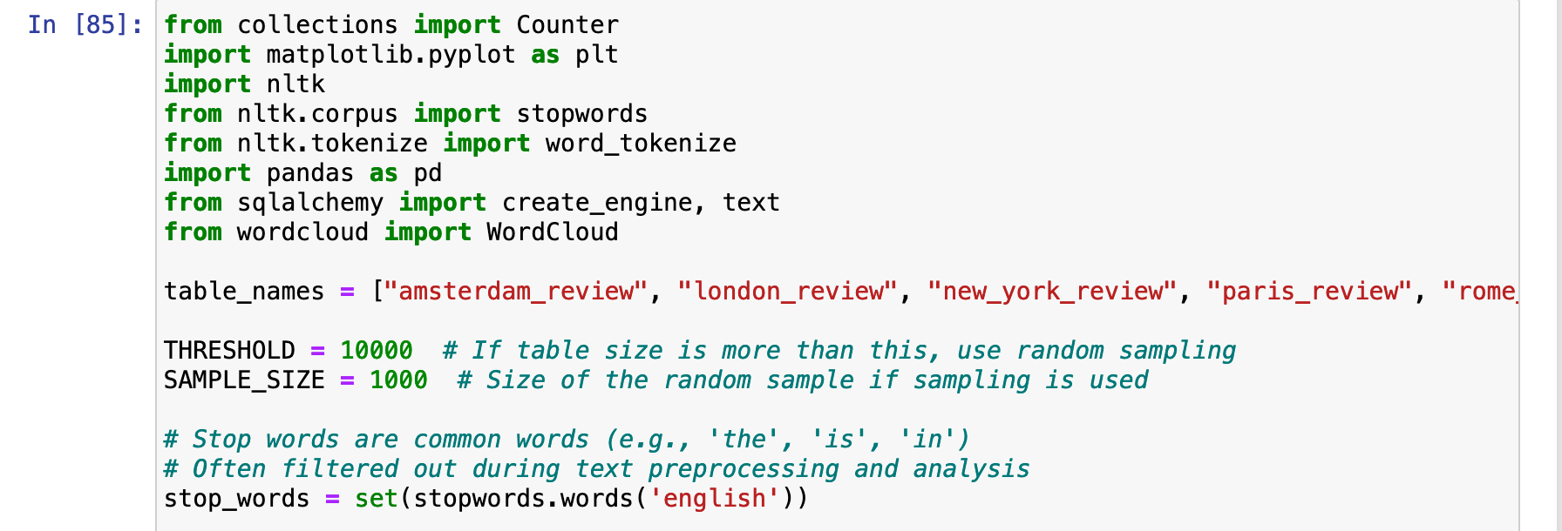
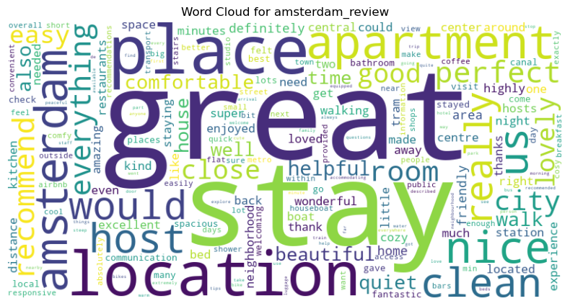
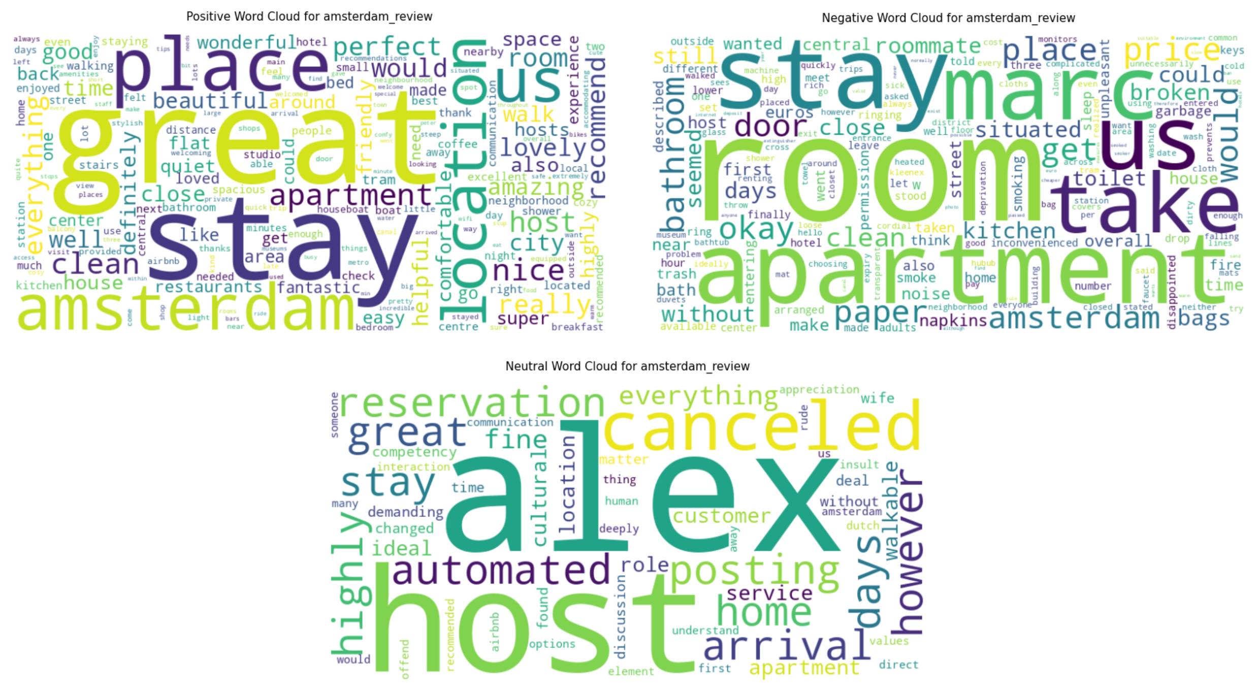

Word Frequency: NLTK + Wordcloud What are the most frequent words for the reviews? What can this tell us about consumer concerns?
Applying sentimental analysis to Word Cloud

Slide 29
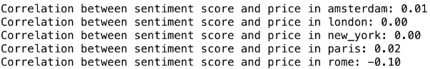
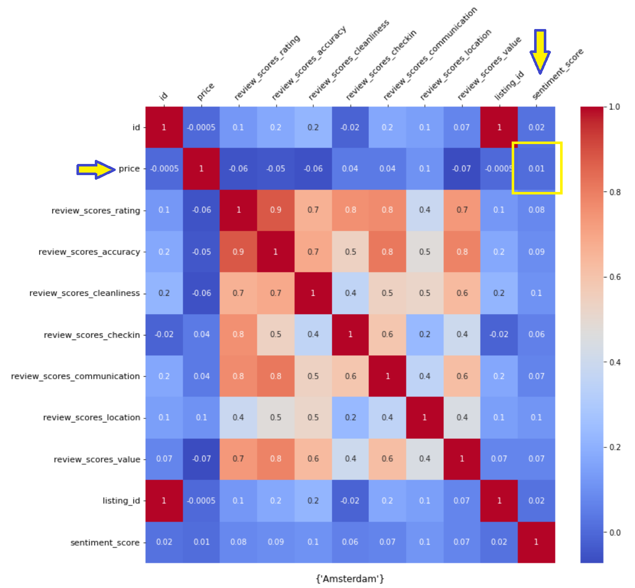
Correlation Heatmap Is there a correlation between price and review sentiment?

Slide 30
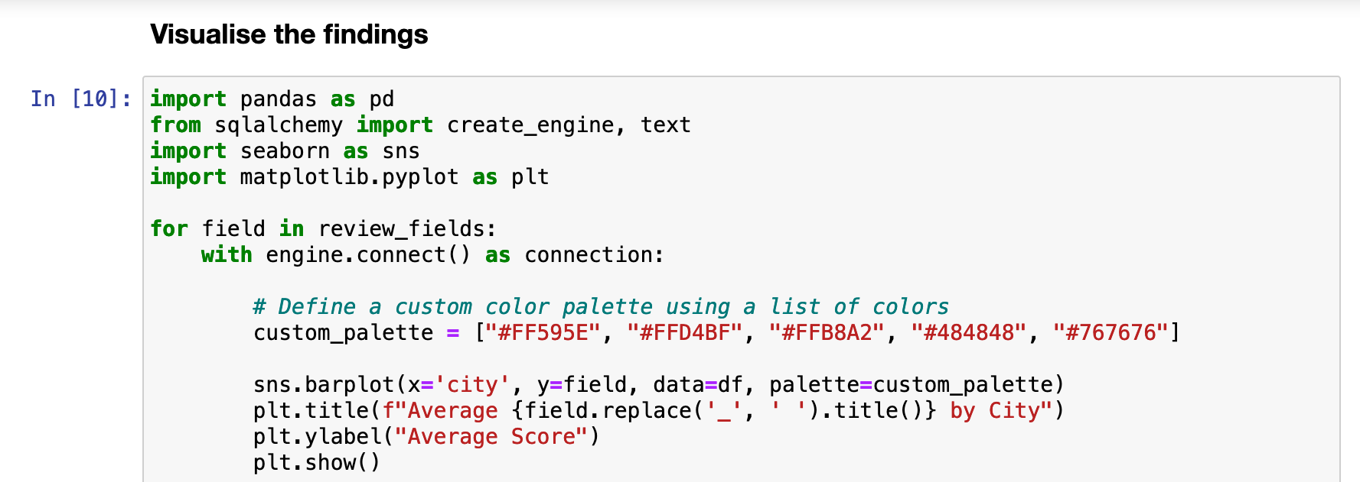
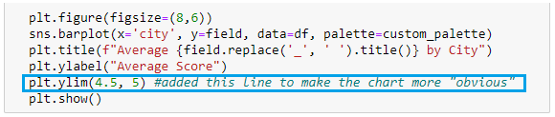
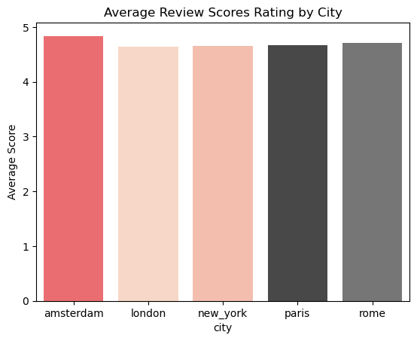
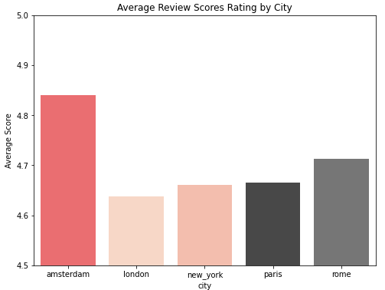
Bar Plot: Seaborn + Matplotlib Which city has the highest rating scores – overall?
Seaborn makes it easy to use colour palettes for plots, with the palette parameter. It is built on top of matplotlib, and they work hand in hand. As such, when fine-tuning graph features such as title, x-axis labels, y-axis labels, it's common to revert to matplotlib commands.

Slide 31
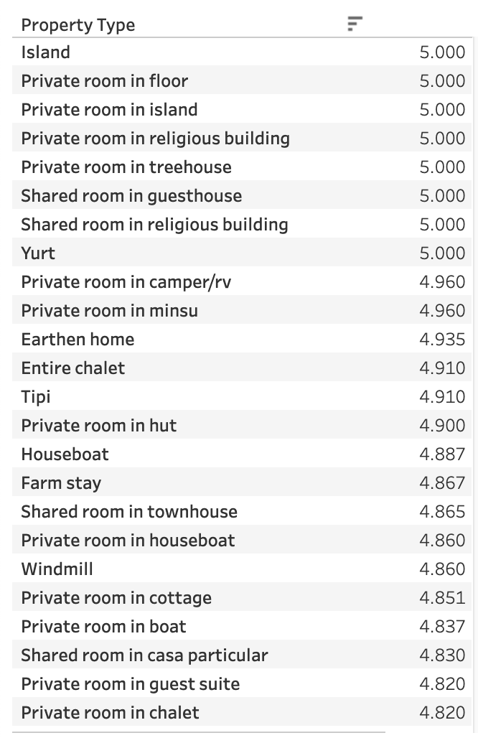
Tableau Public
Best-Rated Airbnb Homes
Which homes are the best rated?

Slide 32
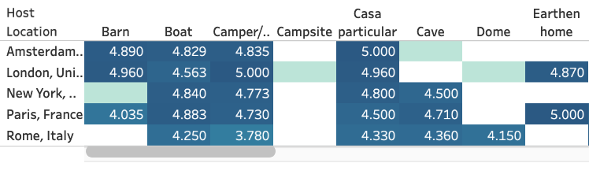
Tableau Public
Ratings by Host Location
How do the home ratings differ by city?

Slide 33
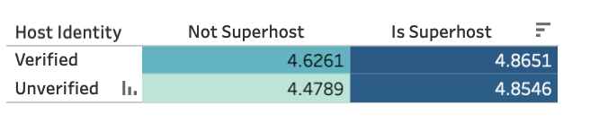
Tableau Public
Do verified hosts and Superhosts get better reviews?
Superhost + Verified ID = Better Reviews?

Slide 34
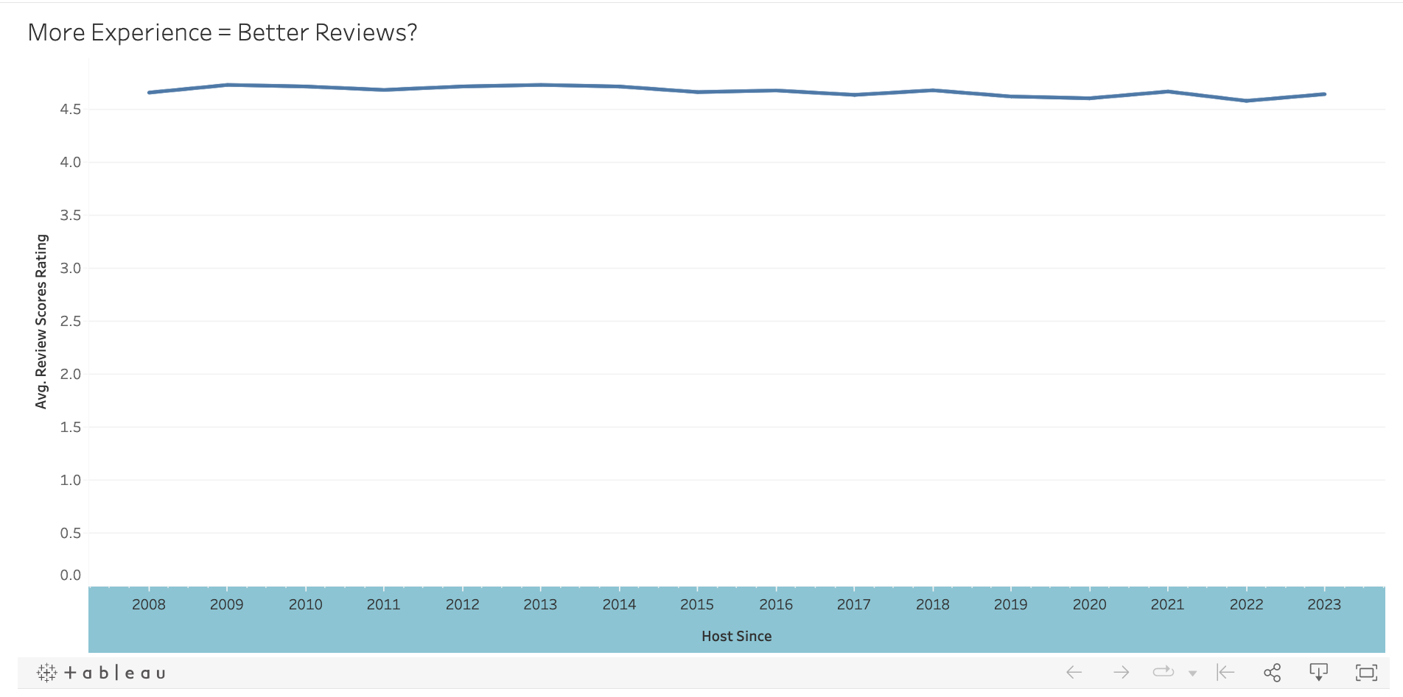
Tableau Public
More Hosting Experience = Better Reviews?
Do experienced hosts get better reviews?

Slide 35
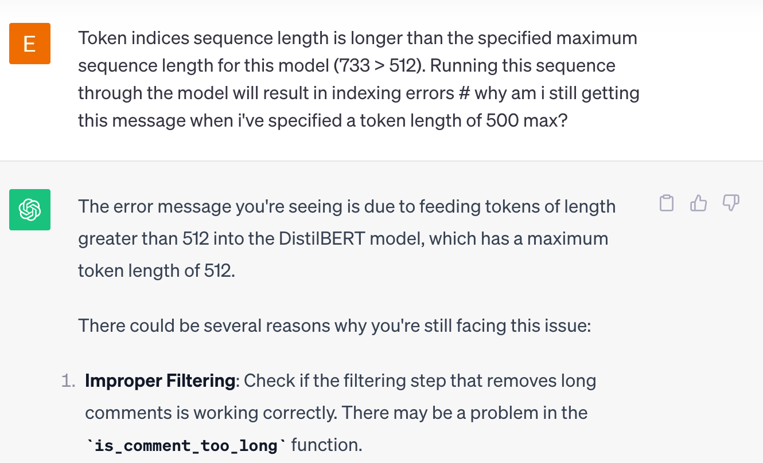
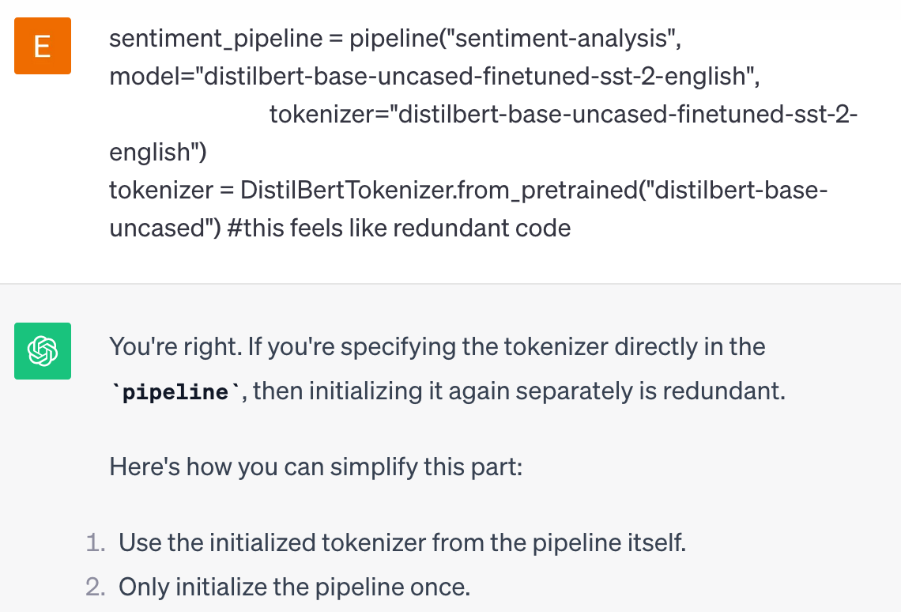
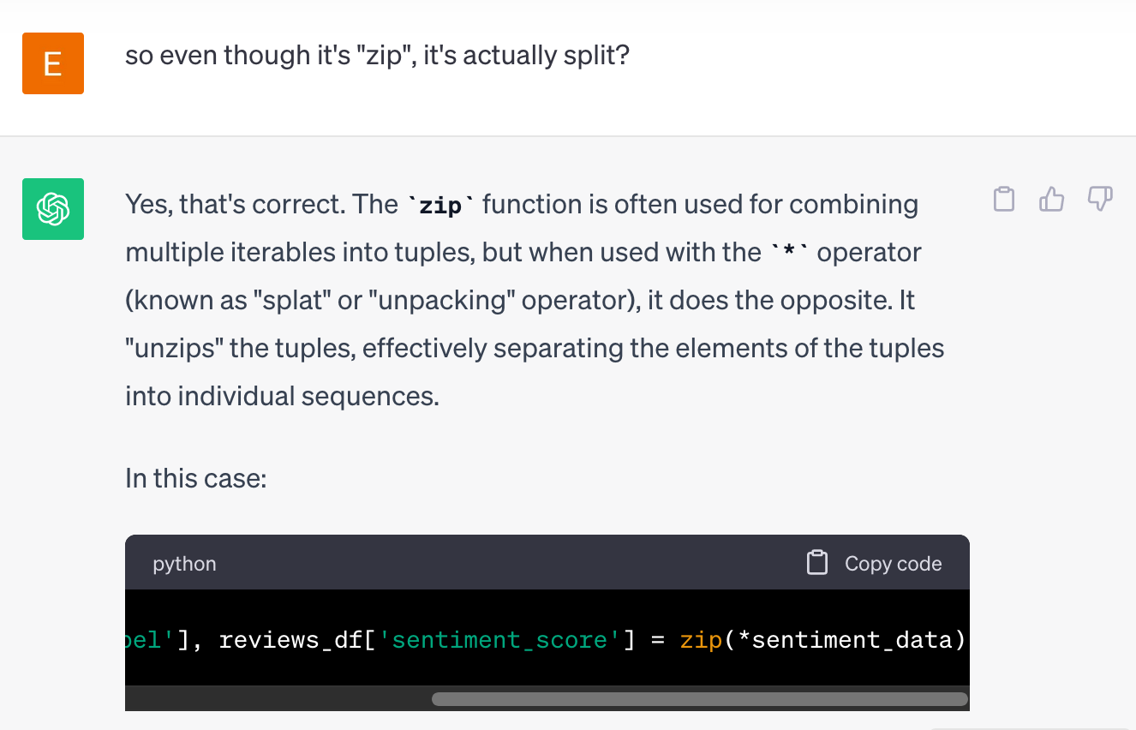
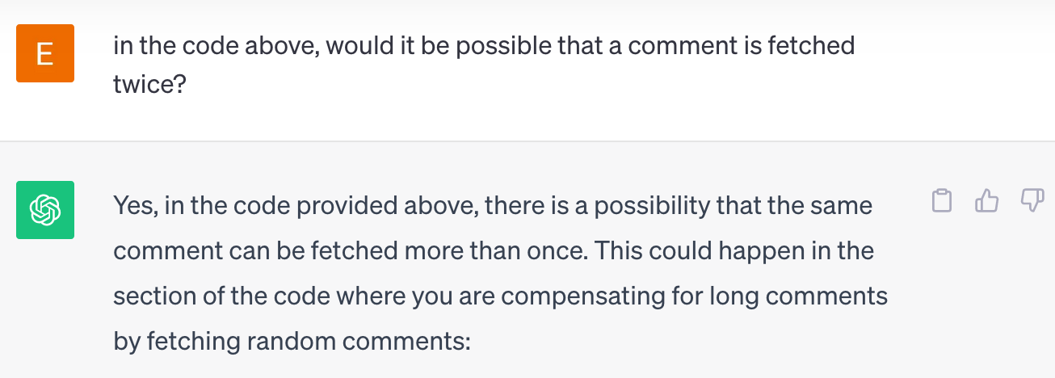
Using ChatGPT: Example Queries
Identifying gaps in existing code:
Troubleshooting:
Clarifying unfamiliar code:

Slide 36
Conclusion
06

Slide 37

Project Challenges + Lessons

Slide 38

Paul Westphal (NBA Hall of Famer)
Have fun doing whatever it is
that you desire to accomplish.
Learn it one step at a time,
emphasizing the fundamentals,
and do it because you love it,
not because it's work.

